Slide 1
Online Shop & inventory management system

Slide 2
Table of Content
Introduction
Robust System Features
Admin Panel Features
Technology
Software Process model
Diagrams For Project.
Key Benefits
Challenges and Effective Solutions
Future Enhancements & Strategic Growth
Conclusion

Slide 3
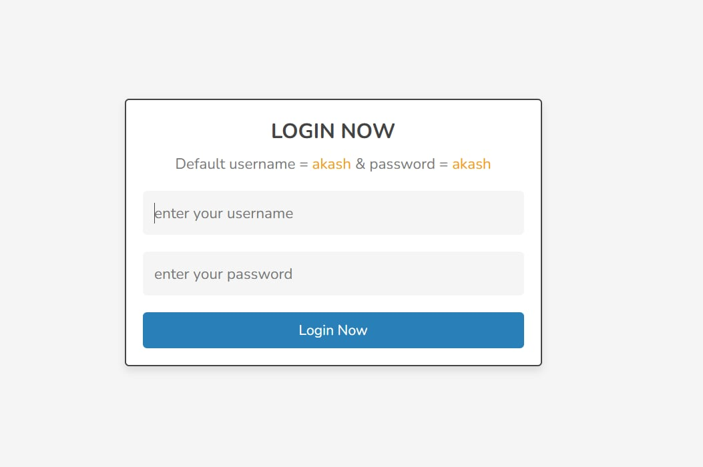
INTRODUCTION
Welcome to our detailed presentation on an integrated online shopping system with inventory management. By combining functions and businesses can enhance operational accuracy, customer satisfaction, and decision-making capabilities.

Slide 4
Robust System Features for User Experience
User Registration & Login
Secure account creation and authentication allow personalized experiences and secure transactions.
Product Catalog with Search & Filter
Advanced searching and filtering options facilitate quick discovery of desired products, improving usability and conversion rates.
Shopping Cart & Checkout
Intuitive cart management paired with a smooth checkout process including payment integration ensures higher order completion.

Slide 5
Robust System Features for User Experience
Payment Gateway Integration
Integration with reliable payment APIs enables secure, seamless money transactions supporting multiple payment methods.
Order Tracking & Confirmation
Real-time updates provide transparency to customers from purchase to delivery, boosting customer trust and retention.

Slide 6
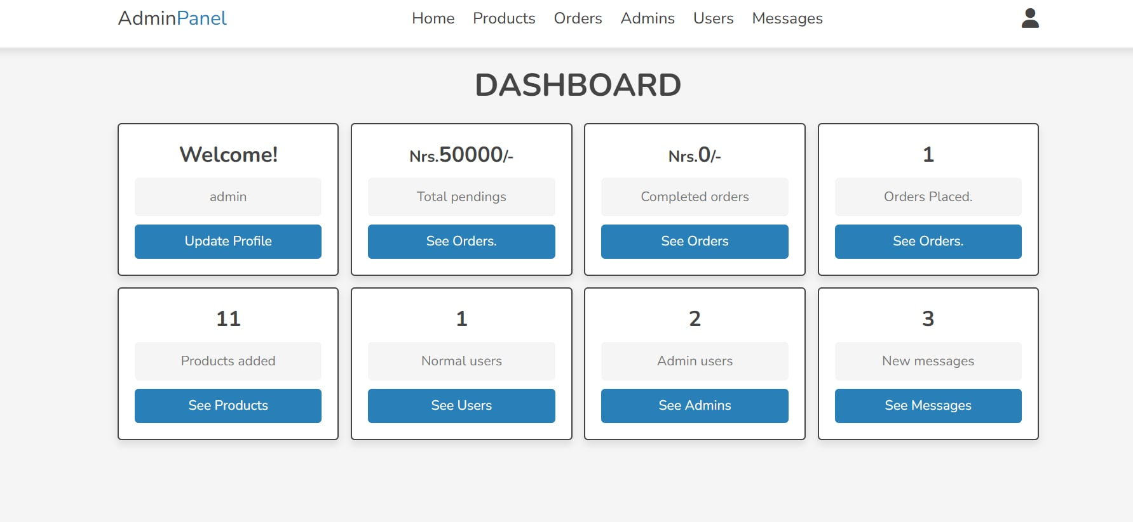
6
Comprehensive Admin Panel Features
Product Management
Ability to add, edit, or remove products efficiently maintaining the catalog up-to-date.
Order Management
Full oversight of order status, processing, and customer interactions from admin side.
Inventory Dashboard
Real-time insights on stock health and alerts for proactive inventory control.
User & Role Management
Manage access permissions to protect sensitive business data and ensure operational security.

Slide 7
Technology Using for the System
Frontend
HTML, CSS, JavaScript (React or Angular)
Responsive and dynamic user interfaces
Database & Payment
MySQL or MongoDB for data persistence
Stripe and PayPal integration for secure payments
Backend
Node.js, Django, or Laravel
API development and server-side business logic

Slide 8
Software Process model:
The process model for our project is selected as Waterfall process model.

Slide 9
Reasons for Choosing the Waterfall Model?
Why we chosen:
The project is relatively small in scope.
The Waterfall model is straightforward, easy to understand, and simple to implement.
Its process activities are well-defined, clearly separated, and logically organized.
This model is well-suited for smaller projects where the requirements are stable and well-understood.
All project requirements have been clearly identified from the outset.
The underlying technology is familiar and well-understood by the development team.
9

Slide 10
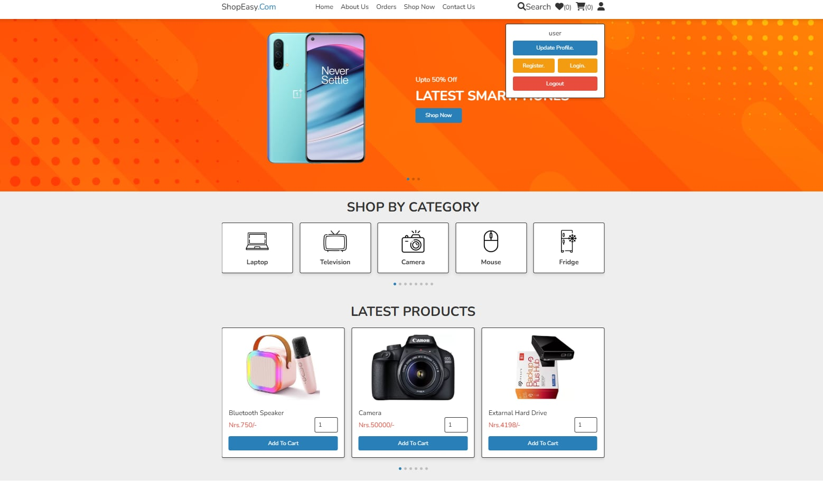
10
Diagrams For Online Shop & Inventory management Project

Slide 11
Use case diagram:
11

Slide 12
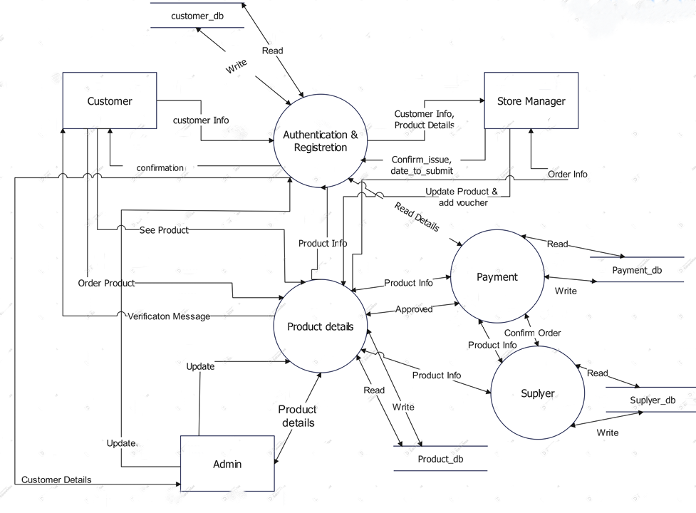
Level 1 DFD:
12

Slide 13
13
Level 2 DFD:

Slide 14
Swim Lane Diagram:
14

Slide 15
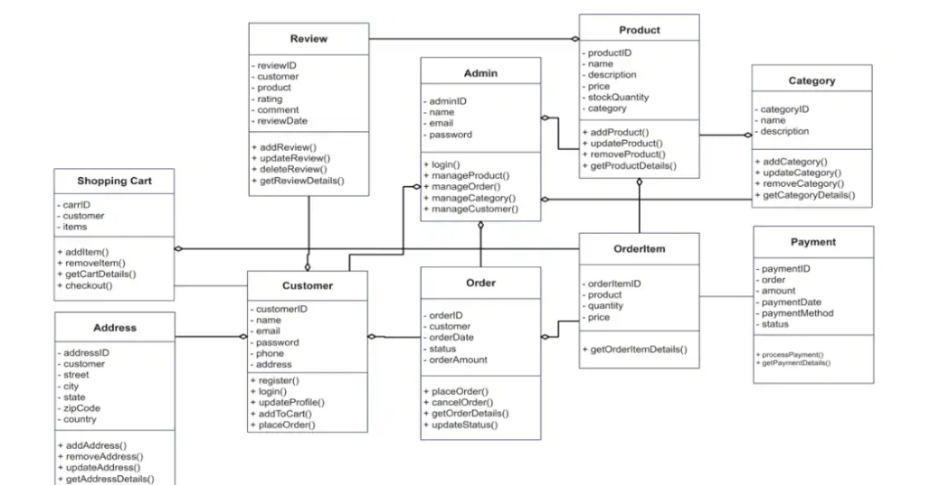
Class Diagram:
15

Slide 16
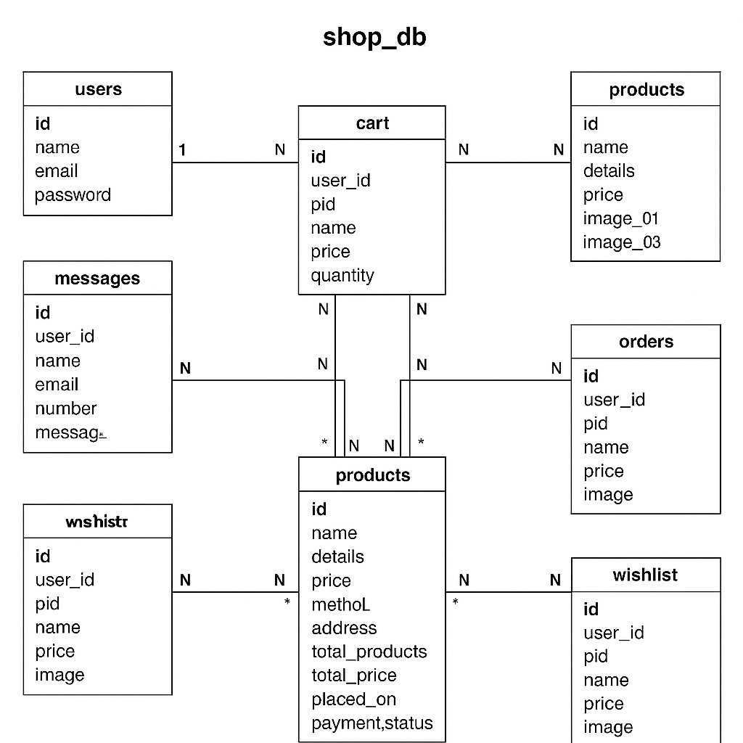
ERD Diagram:
16

Slide 17
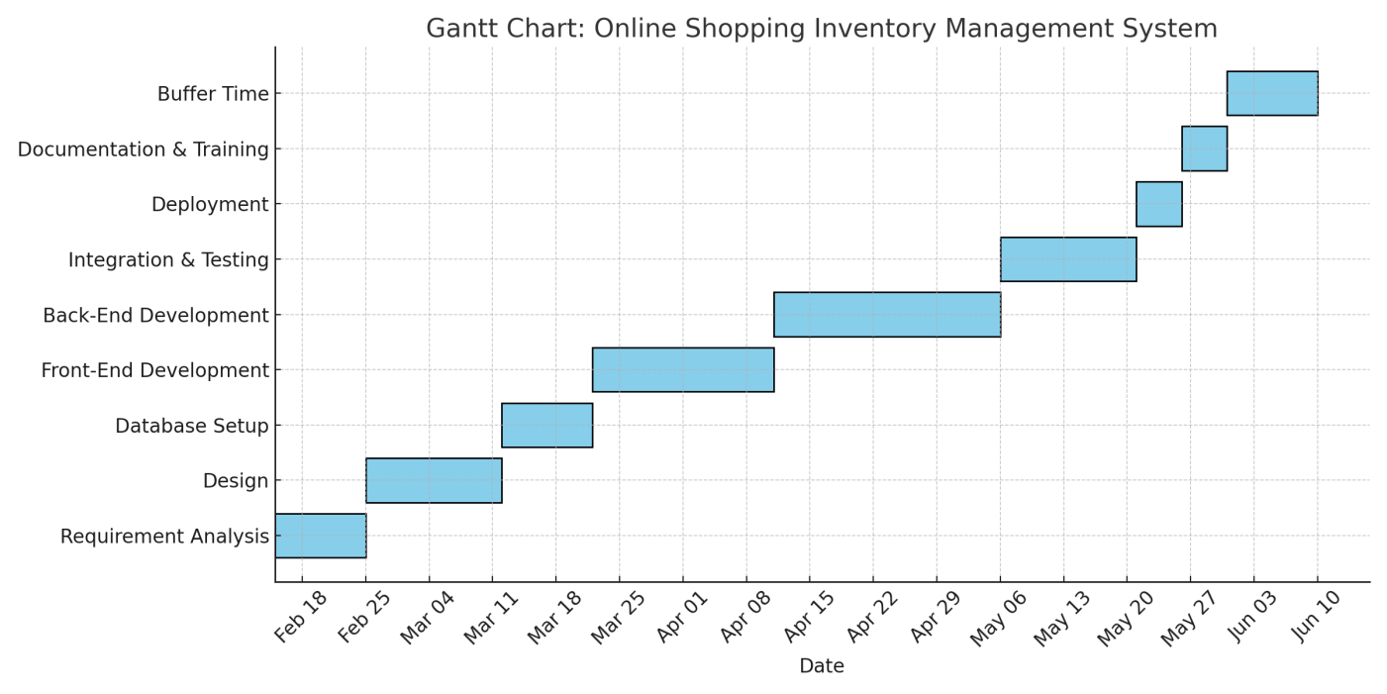
17
Project Gantt Chart :

Slide 18
Key Benefits For Project Success
Improved Customer Experience
Faster and intuitive shopping with reliable order tracking enhances satisfaction and loyalty.
Reduced Overselling Risk
Real-time inventory reduces stock discrepancies, preventing costly order fulfillment errors.
Efficient Inventory Control
Automation decreases manual workload and improves accuracy, enabling better resource allocation.
Data-Driven Business Decisions
Comprehensive analytics empower strategic planning and supply chain optimization.

Slide 19
Challenges and Effective Solutions
High Traffic Management
Cloud hosting and caching strategies dynamically scale to meet demand spikes.
Security
SSL encryption, secure payment processing, and robust user authentication safeguard data.
Inventory Synchronization
Real-time APIs and database triggers assure data consistency across platforms.

Slide 20
Future Enhancements & Strategic Growth
Mobile App Integration
Expanding access with dedicated mobile applications for seamless shopping on the go.
AI-Based Recommendations
Personalized product suggestions to increase engagement and average order value.
Multi-Vendor Support
Allowing multiple sellers to grow product variety and market presence.
Delivery Partner Integration
Streamlined logistics coordination to enhance delivery speed and tracking accuracy.

Slide 21
Conclusion
21
The Inventory Management System is a scalable, secure, and efficient tool tailored for businesses to track and manage inventory, suppliers, and sales/purchase records.
Developed with modern web technologies and guided by Agile principles, the system ensures adaptability and user-centric design. It aligns with both functional and business requirements and sets a strong foundation for future expansion.

Slide 22
Thank you

